Slide 1

HDFC Bank Digital KYC Dashboard
AI-Powered Solution to Lift Conversion 70% → 90%
Dipam Barman | B.Tech CSE, 7th Semester | Gauhati University
December 2025
Live Demo: digital-kyc-dashboard.vercel.app

Slide 2
The Challenge: 30% Drop-Off in Digital KYC
35%
25%
60%
20%
Document Scan Failures
Upload Failures
Steps Exceed SLA
Auto-Rejected Users
Wrong type or duplicate detection issues
Process takes 55-60s vs 20s target
Hit 3-attempt limit and abandon
Blurry, dark, or glare-affected images
Current State
Target State
70% Conversion ❌
90% Conversion ✅
Missing 24,000 customers/year
₹120M revenue opportunity

Slide 3


Why Are Customers Dropping Off?
Poor Image Quality
Late Error Detection
No real-time guidance
Duplicates found after upload
Blurry or dark captures
Wrong document type missed
Glare on documents
No early validation
Result: 35% scan failures
Result: 25% upload failures
Hard Rejection
No save & resume option
Generic error messages
3-strike auto-rejection
Result: 20% users abandon
Users retry 2-3 times before giving up entirely

Slide 4
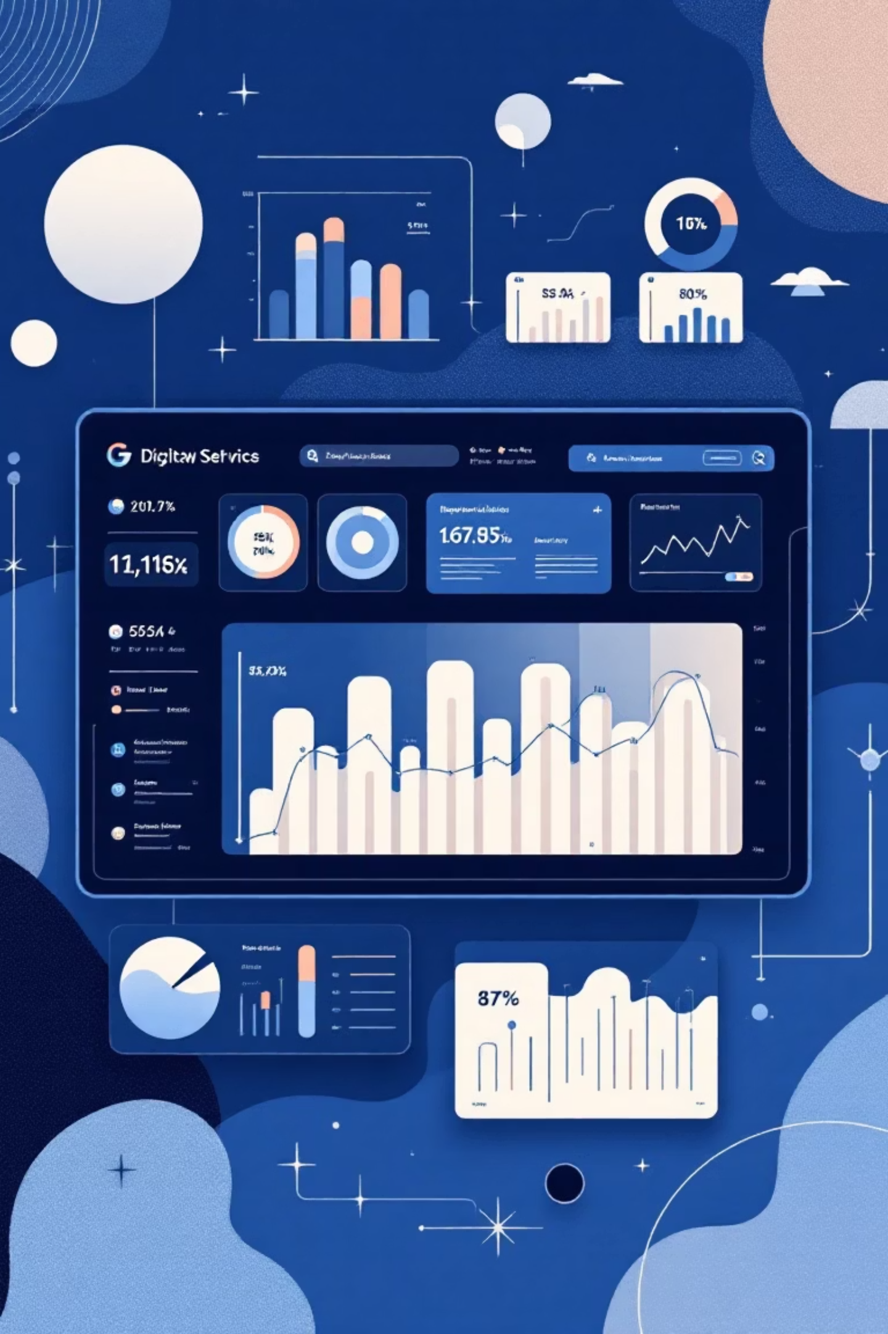

Our Approach: 4 Strategic Solutions
AI Quality Validation
Real-time document analysis with Gemini
Detect blur, glare, darkness instantly
Impact: 35% → 12% failures
Fewer Abandonments
Soft rejection with save & resume
Pre-selected recommended documents
Impact: Save 20% of users
Faster TAT
Client-side validation
Parallel AI processing
Impact: 28-33s → <20s
Clearer Visibility
Step progress tracker (1-5)
Specific error messages
Impact: Fix on 1st retry

Slide 5

The Game Changer: Gemini Vision API
Feature
Gemini
AWS Textract
Custom ML
Speed
✅ <2s
⚠️ 3-5s
✅ <2s
Accuracy
✅ 95%+
✅ 90%+
🔄 Varies
Cost
✅ ₹0.25
❌ ₹0.50
❌ High
Setup
✅ 1 day
⚠️ 3-5 days
❌ 2-3 mo
Indian Docs
✅✅✅
✅
🔄 Training
Why Gemini?
Lightning-fast <2s analysis
95%+ accuracy on Indian documents
Cost-effective ₹0.25 per image
1-day setup vs weeks for alternatives
Quality Detection
Document Verification
OCR Extraction
Instantly identifies blur, glare, darkness
Validates PAN, Aadhaar, Passport types
Early duplicate check before upload

Slide 6





Real-Time AI Flow
Step 1: Capture
User scans document with camera overlay guidance
Step 2: Gemini Analyzes
Quality: 87%
Type: PAN Card ✓
Duplicates: None ✓
Step 3: Instant Feedback
"Great quality!"
"Ready to upload"
"No duplicates found"
Step 4: Smart Upload
Passes all checks → No retries → First-time success!
Result: Happy user + faster conversion + reduced support burden

Slide 7


Business Impact & ROI
Document Scan Failures
Upload Failures
Overall Conversion
Before: 25% ❌
Before: 70% ❌
Before: 35% ❌
After: 10% ✅
After: 90% ✅
After: 12% ✅
60% improvement
+20% lift
66% improvement
24K
₹120M
60%
New Customers/Year
Annual Revenue
Fewer Support Tickets
Previously lost to drop-offs
LTV ₹5K per customer
"Why was I rejected?" queries eliminated
4000x
ROI
₹120M revenue vs ₹30K AI cost
Implementation: 14 weeks | Payback: Less than 1 month

Slide 8
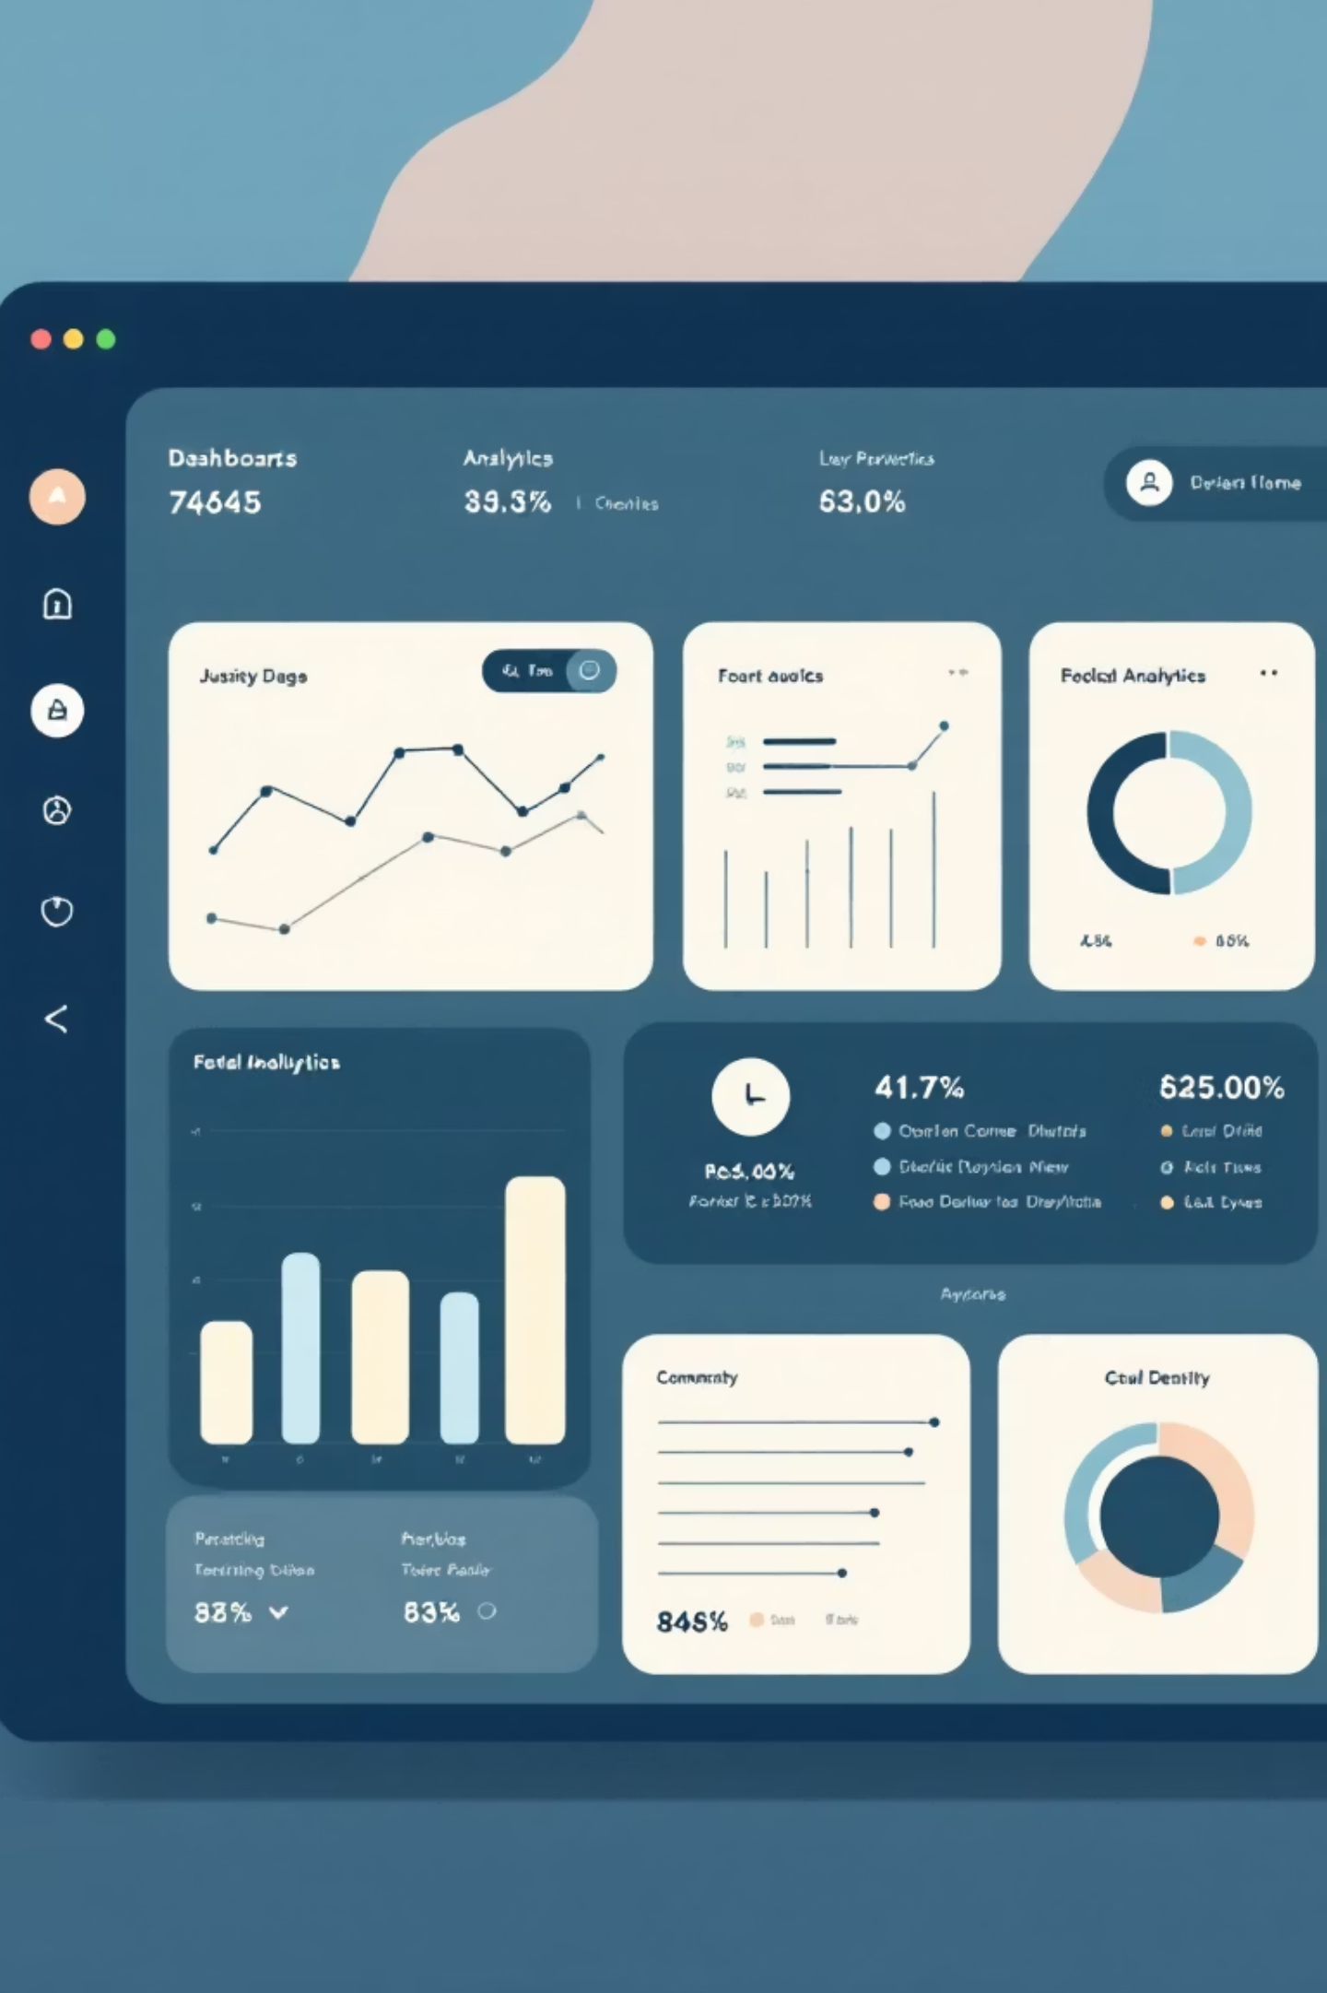
What We Built: Live Demo
Data Visualization
Funnel chart shows exact drop-offs
Metrics table tracks failure % per stage
Error insights reveal top reasons
Interactive KYC Demo
5-step simulated flow
Real-time quality feedback
Before/after comparison
AI Document Scanner
Upload & instant analysis
Quality score (0-100%)
Accept/Reject recommendation
Solution Cards
4-pronged approach breakdown
Problem → Solution → Impact mapping
Gemini AI benefits showcase
Tech Stack: Next.js 14 | TypeScript | Tailwind CSS | Gemini AI | Vercel
Live: digital-kyc-dashboard.vercel.app

Slide 9
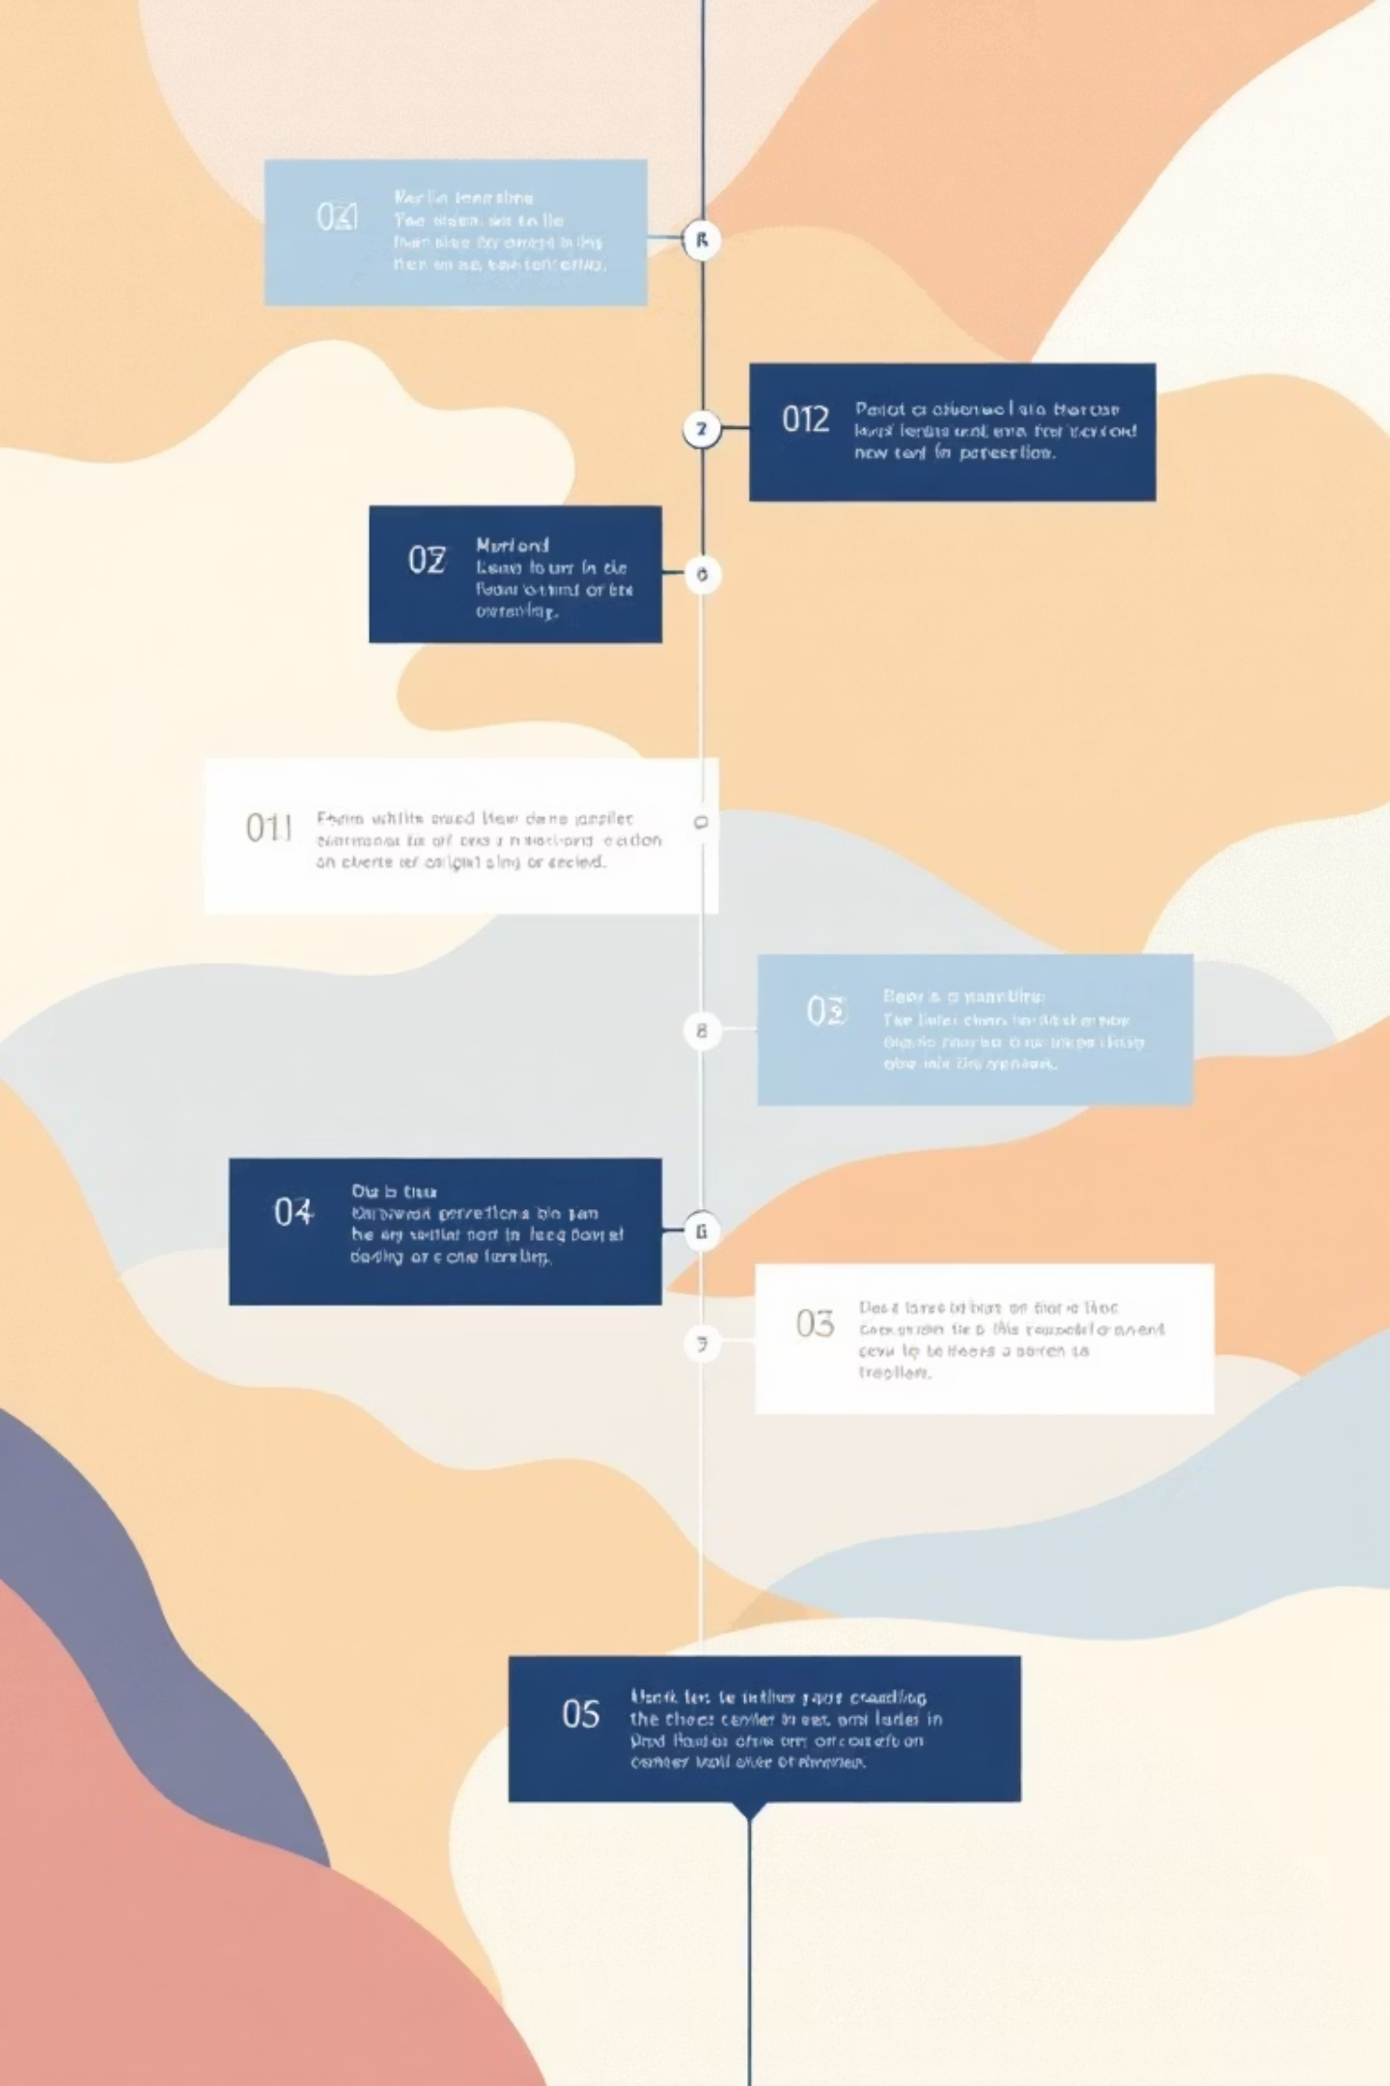
14-Week Rollout Plan
1
Phase 1: AI & UX
Weeks 1-4
Gemini API integration
Camera overlay + guidance
Client-side validation
Deliverable: MVP with Gemini
2
Phase 2: Backend & Optimization
Weeks 5-8
API performance tuning
Early duplicate detection
Specific error messaging
Deliverable: Production-ready
3
Phase 3: Testing & Launch
Weeks 9-14
A/B testing (old vs new)
Gradual rollout (10% → 100%)
Monitor KPIs & iterate
Deliverable: Full rollout
Success Metrics
✓ Conversion rate
✓ Stage failures
✓ Support tickets
✓ User satisfaction

Slide 10
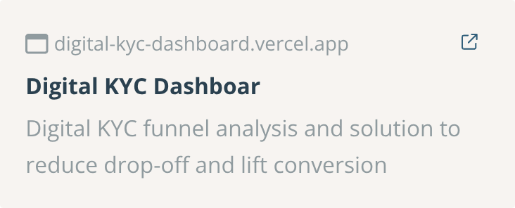
Transform HDFC's KYC Experience
01
02
03
Explore Live Demo
Approve Gemini Integration
Start 14-Week Rollout
Fast, accurate, cost-effective
Expected +₹120M annual revenue
Industry-standard AI solution
60% support ticket reduction
See all features in action
Project Credits
👤 Dipam BarmanB.Tech CSE (7th Sem) | Gauhati University
🚀 Next.js, TypeScript, Tailwind, Vercel
📧 dipambarman@outlook.com
🤖 Google Gemini 1.5 Flash Vision API
💻 github.com/dipambarman
📚 HDFC Bank case study (anonymized data)
"AI transforms KYC from painful friction to delightful first experience."

